Slide 1

Quaternion-Valued Solutions to the KdV Equation
John Cobb, Alex Kasman, Albert Serna, Monique Sparkman
Notes:
Add summary of what we are going to talk about

Slide 2
KdV Equation and History
Quaternions
The Direct Scattering Problem
Two Soliton Interactions-Phase Shifts
Rations Solutions

Slide 3
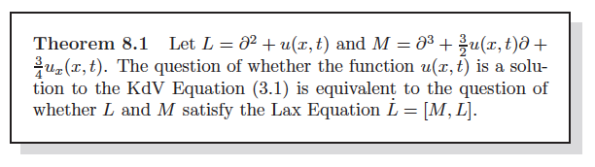
The KdV Equation
In 1843 John Scott Russell observes a “wave of translation.”
KdV Equation: $u_{t}=\frac{3}{2}uu_{x}+\frac{1}{4}u_{xxx}$
Has n-soliton solutions and can be solved exactly.

Slide 4
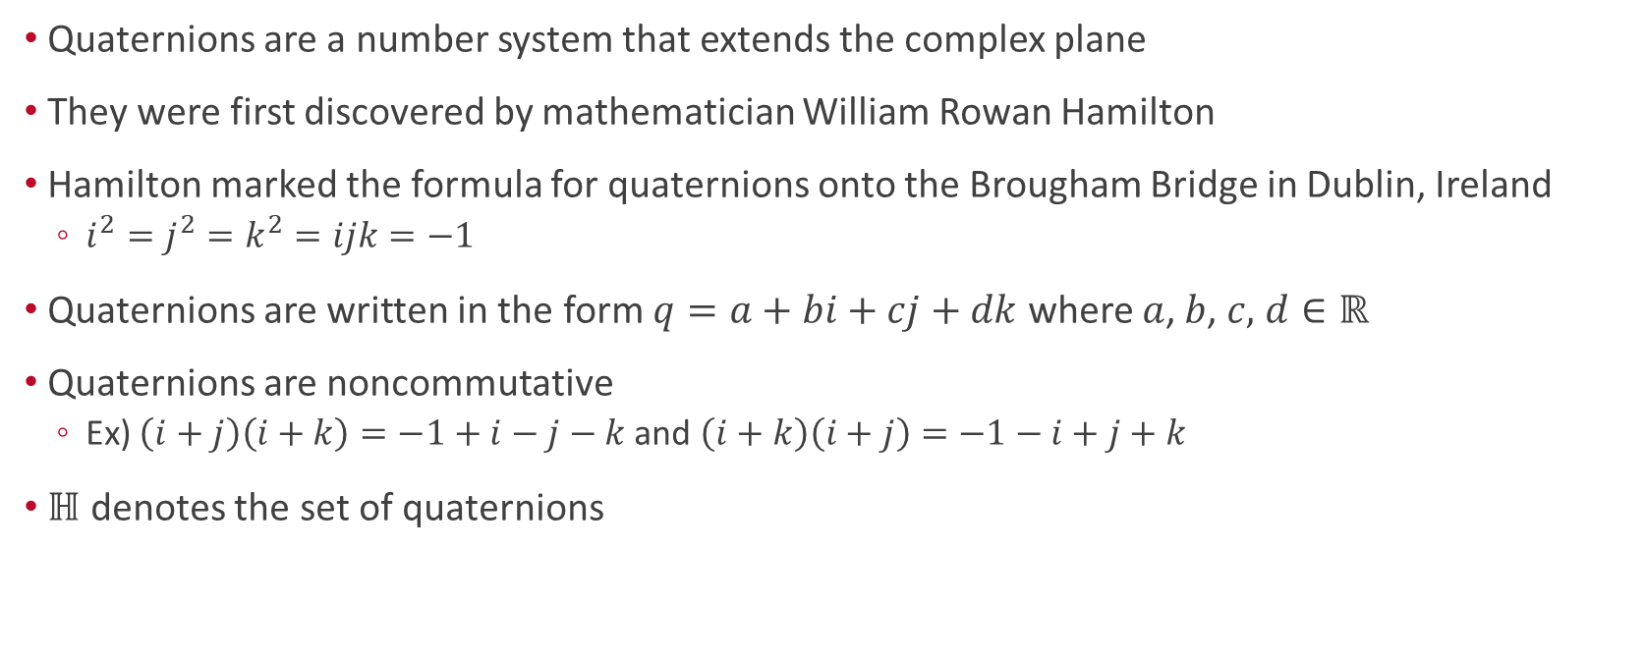
Quaternions
Quaternions are a number system that extends the complex plane
They were first discovered by mathematician William Rowan Hamilton
Hamilton marked the formula for quaternions onto the Brougham Bridge in Dublin, Ireland
$i^{2}=j^{2}=k^{2}=ijk=−1$
Quaternions are written in the form $q=a+bi+cj+dk$ where $a$, $b$, $c,$ $d∈ℝ$
Quaternions are noncommutative
Ex) $\left(i+j\right)\left(i+k\right)=−1+i−j−k$and $\left(i+k\right)\left(i+j\right)=−1−i+j+k$
$ℍ$ denotes the set of quaternions

Slide 5
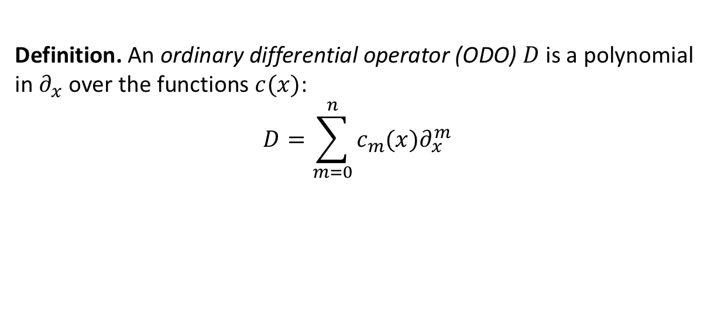
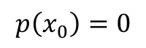
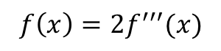
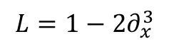
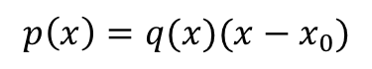
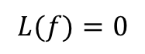
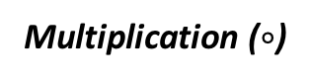
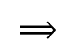
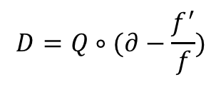

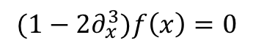
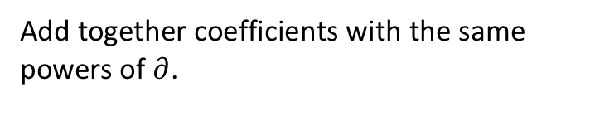
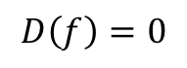
Generating QKdV Solutions: Differential Operators
“factor”
$$L(f)=0$$
$$f\left(x\right)={2f}^{′′′}(x)$$
$$⟹$$
$${(1−2∂}_{x}^{3})f\left(x\right)=0$$
$${L=1−2∂}_{x}^{3}$$
While you may think of an ODO as shorthand notation for a differential equation, it has its own separate existence
Definition. An ordinary differential operator (ODO) $D$ is a polynomial in $∂_{x}$ over the functions $c(x)$:
$$D=\sum_{m=0}^{n}{c_{m}(x)∂_{x}^{m}}$$
Addition
Add together coefficients with the same powers of $∂$.
Multiplication ($∘$)
Defined so that $D∘Q$ satisfies
$$D∘Q \left(f\right)=D\left(Q \left(f\right)\right).$$
“Normal” Polynomials
Differential operators
$$p\left(x_{0}\right)=0$$
$$D\left(f\right)=0$$
(In fact, there is a way to create differential operators that contain any given space in its kernel)
iff
iff
$$D=Q∘(∂−\frac{f^{′}}{f})$$
$$p\left(x\right)=q(x)(x−x_{0})$$

Slide 6
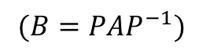
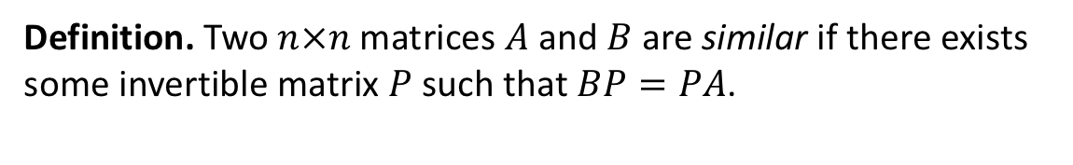
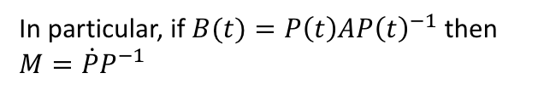
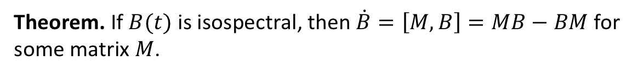
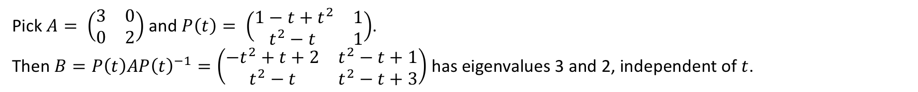
Generating QKdV Solutions: Isospectrality
Note: Maybe this was covered in your first course on linear algebra under the concept of “change of bases”.
Definition. Two $n×n$matrices $A$and $B$are similar if there exists some invertible matrix $P$ such that $BP=PA$.
$$(B=PAP^{−1})$$
Similar matrices are isospectral: this means they have the same eigenvalues.
Proof. Let $v$be an eigenvector of $A$ so that $Av=λv$. Then applying matrix $B$ to vector $Pv$ yields $B\left(Pv\right)=PAP^{−1}\left(Pv\right)=PAv=λ(Pv)$. So $λ$ is an eigenvalue of $B$ also. $∎$
Example.
“dressing”
We can use this construct time-dependent matrices that have constant eigenvalues. (We’ll call these isospectral as well)
Pick $A= \left(\begin{matrix}3 & 0 \\ 0 & 2\end{matrix}\right)$ and $P\left(t\right)= \left(\begin{matrix}1−t+t^{2} & 1 \\ t^{2}−t & 1\end{matrix}\right)$.
Then $B=P\left(t\right)AP{\left(t\right)}^{−1}=\left(\begin{matrix}−t^{2}+t+2 & t^{2}−t+1 \\ t^{2}−t & t^{2}−t+3\end{matrix}\right)$ has eigenvalues 3 and 2, independent of $t$.
Seemingly random fact:
Theorem. If $B(t)$ is isospectral, then $\dot{B}=\left[M,B\right]=MB−BM$ for some matrix $M$.
In particular, if $B(t)=P\left(t\right)AP{\left(t\right)}^{−1}$ then $M=\dot{P}P^{−1}$
So differentiating isospectral matrices is like taking a commutator.

Slide 7
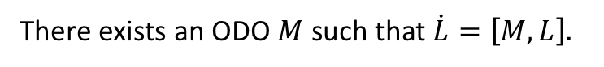
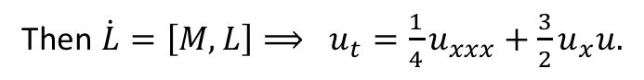
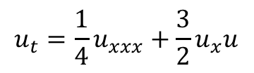
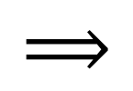
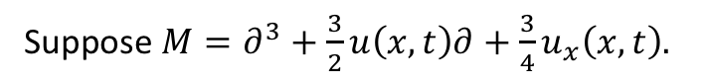
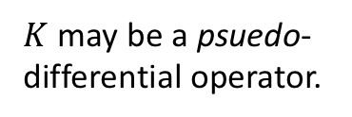
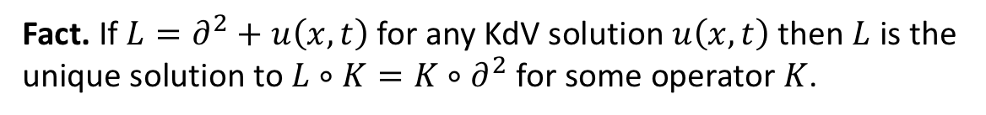

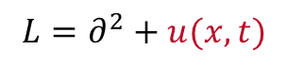
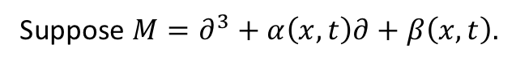
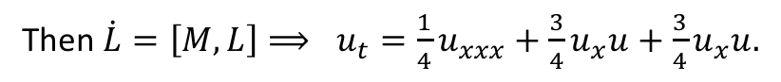
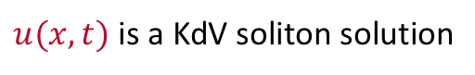
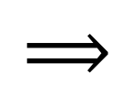
Generating QKdV Solutions: The Darboux Trick
Like matrices, differential operators have eigenfunctions with corresponding eigenvalues. They can also be isospectral.
1967
Gardner, Greene, Kruskal, and Miura
1968
Peter Lax
$$u_{t}=\frac{1}{4}u_{xxx}+\frac{3}{2}u_{x}u$$
$$⟹$$
$$⟹$$
$$L=∂^{2}+u(x,t)$$
There exists an ODO $M$ such that $\dot{L}=\left[M,L\right].$
$u(x,t)$ is a KdV soliton solution
The operator $L$ is isospectral
Lax form
Suppose $M=∂^{3}+\frac{3}{2}u\left(x,t\right)∂+\frac{3}{4}u_{x}\left(x,t\right).$
Then $\dot{L}=\left[M,L\right]⟹ u_{t}=\frac{1}{4}u_{xxx}+\frac{3}{2}u_{x}u.$
Then $\dot{L}=\left[M,L\right]⟹ u_{t}=\frac{1}{4}u_{xxx}+\frac{3}{2}u_{x}u+c_{1}u_{x}$ for some constant $c_{1}.$
Suppose $M=∂^{3}+\frac{3}{2}u\left(x,t\right)∂+\frac{3}{4}u_{x}\left(x,t\right)$ and $u\left(x,t\right)$ is quaternion valued.
Then $\dot{L}=\left[M,L\right]⟹ u_{t}=\frac{1}{4}u_{xxx}+\frac{3}{4}u_{x}u+\frac{3}{4}u_{x}u.$
Suppose $M=∂^{3}+α\left(x,t\right)∂+β\left(x,t\right).$
So is $L$ just some ”dressed” up ODO operator of some simpler constant ODO? (i.e. is it ”similar” to some simpler matrix?)
Fact. If $L=∂^{2}+u\left(x,t\right)$ for any KdV solution $u\left(x,t\right)$ then $L$ is the unique solution to $L∘K=K∘∂^{2}$ for some operator $K$.
$K$ may be a psuedo-differential operator.
The ”Darboux trick” is to exploit this isospectral behavior to generate new solutions via “dressing”.
Pick $A= \left(\begin{matrix}3 & 0 \\ 0 & 2\end{matrix}\right)$ and $P\left(t\right)= \left(\begin{matrix}1−t+t^{2} & 1 \\ t^{2}−t & 1\end{matrix}\right)$. Then $B=P\left(t\right)AP{\left(t\right)}^{−1}=\left(\begin{matrix}−t^{2}+t+2 & t^{2}−t+1 \\ t^{2}−t & t^{2}−t+3\end{matrix}\right)$ has eigenvalues 3 and 2, independent of $t$.

Slide 8
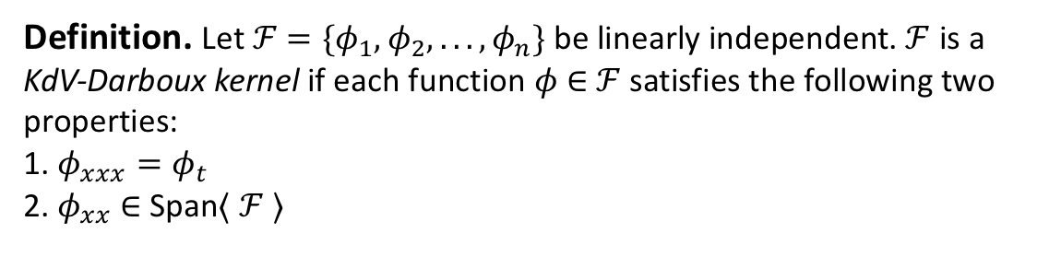
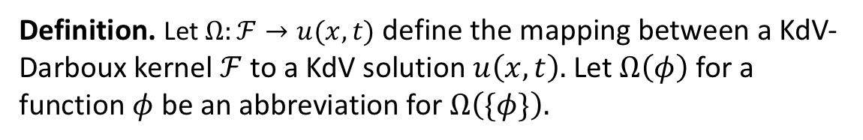
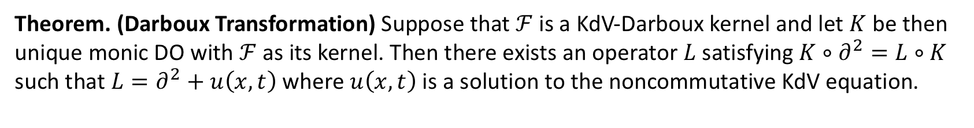
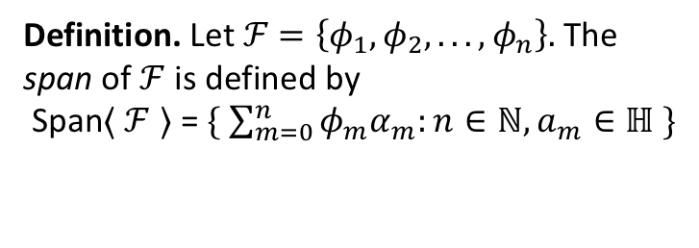
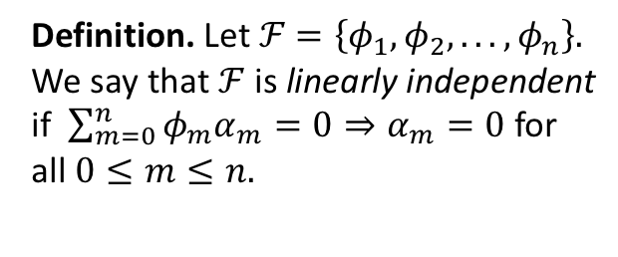
Generating QKdV Solutions: The Darboux Trick
Definition. Let $ℱ$ $=\left\{φ_{1},φ_{2}, . . ., φ_{n}\right\}.$ We say that $ℱ$ is linearly independent if $\sum_{m=0}^{n}{φ_{m}α_{m}=0⇒α_{m}=0}$ for all $0≤m≤n.$
Definition. Let $ℱ$ $=\{φ_{1},φ_{2}, . . ., φ_{n}\}$ be linearly independent. $ℱ$ is a KdV-Darboux kernel if each function $φ$ ∈ $ℱ$ satisfies the following two properties:
1. $φ_{xxx}=φ_{t}$ 2. $φ_{xx}$ ∈ Span⟨ $ℱ$⟩
Definition. Let $ℱ$ $=\left\{φ_{1},φ_{2}, . . ., φ_{n}\right\}.$ The span of $ℱ$ is defined by
Span⟨ $ℱ$⟩ = $\{ \sum_{m=0}^{n}{φ_{m}α_{m}:n∈ℕ, a_{m}∈ℍ} \}$
Theorem. (Darboux Transformation) Suppose that $ℱ$ is a KdV-Darboux kernel and let $K$ be then unique monic DO with $ℱ$ as its kernel. Then there exists an operator $L$ satisfying $K∘∂^{2}=L∘K$ such that $L=∂^{2}+u\left(x,t\right)$ where $u\left(x,t\right)$ is a solution to the noncommutative KdV equation.
Definition. Let $Ω:ℱ→u(x,t)$ define the mapping between a KdV-Darboux kernel $ℱ$ to a KdV solution $u\left(x,t\right).$ Let $Ω\left(φ\right)$ for a function $φ$ be an abbreviation for $Ω\left(\{φ\}\right).$

Slide 9
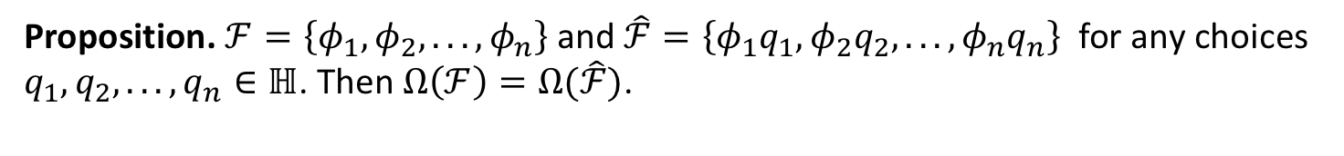

Generating QKdV Solutions: The Darboux Trick
Proposition. $ℱ=\left\{φ_{1},φ_{2},. . ., φ_{n}\right\}$ and $\hat{ℱ}=\left\{φ_{1}q_{1},φ_{2}q_{2},. . ., φ_{n}q_{n}\right\}$ for any choices $q_{1},q_{2},. . ., q_{n}∈ℍ$. Then $Ω\left(ℱ\right)=Ω(\hat{ℱ})$.
This proof is short, should I include it?
Proposition. $ℱ=\left\{φ_{1},φ_{2},. . ., φ_{n}\right\}$ and $\hat{ℱ}=\left\{{qφ}_{1},qφ_{2},. . ., qφ_{n}\right\}$ for any choices $q ∈ℍ$. Then $Ω\left(ℱ\right)=qΩ\left(\hat{ℱ}\right)q^{−1}$.

Slide 10
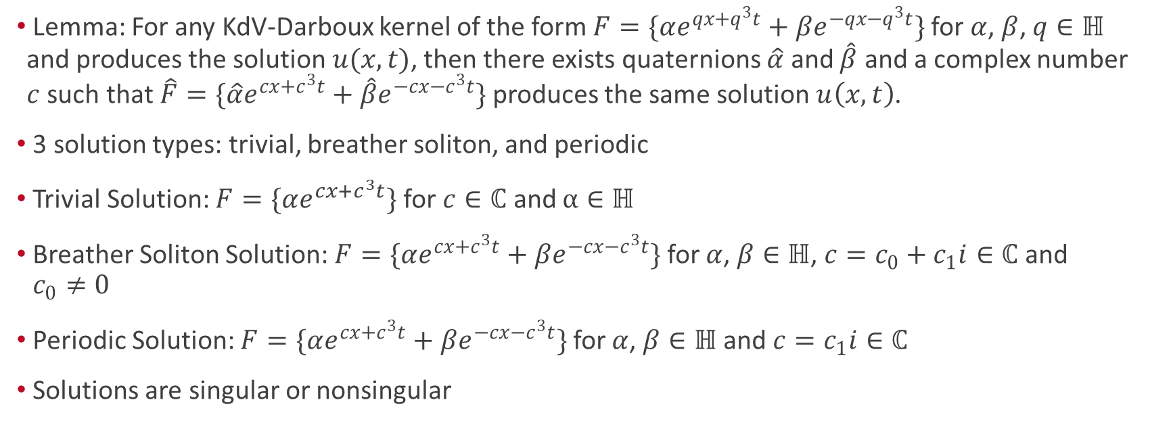
1-Soliton Singularities
Lemma: For any KdV-Darboux kernel of the form $F=\{αe^{qx+q^{3}t}+βe^{−qx−q^{3}t}\}$for $α$, $β$, $q∈ℍ$ and produces the solution $u(x,t)$, then there exists quaternions $\hat{α}$ and $\hat{β}$ and a complex number $c$ such that $\hat{F}=\{\hat{α}e^{cx+c^{3}t}+\hat{β}e^{−cx−c^{3}t}\}$ produces the same solution $u\left(x,t\right)$.
3 solution types: trivial, breather soliton, and periodic
Trivial Solution: $F=\{αe^{cx+c^{3}t}\}$ for $c∈ℂ$ and $α∈ℍ$
Breather Soliton Solution: $F=\{αe^{cx+c^{3}t}+βe^{−cx−c^{3}t}\}$ for $α$, $β∈ℍ$, $c=c_{0}+c_{1}i∈ℂ$ and $c_{0}≠0$
Periodic Solution: $F=\{αe^{cx+c^{3}t}+βe^{−cx−c^{3}t}\}$ for $α$, $β∈ℍ$ and $c=c_{1}i∈ℂ$
Solutions are singular or nonsingular

Slide 11
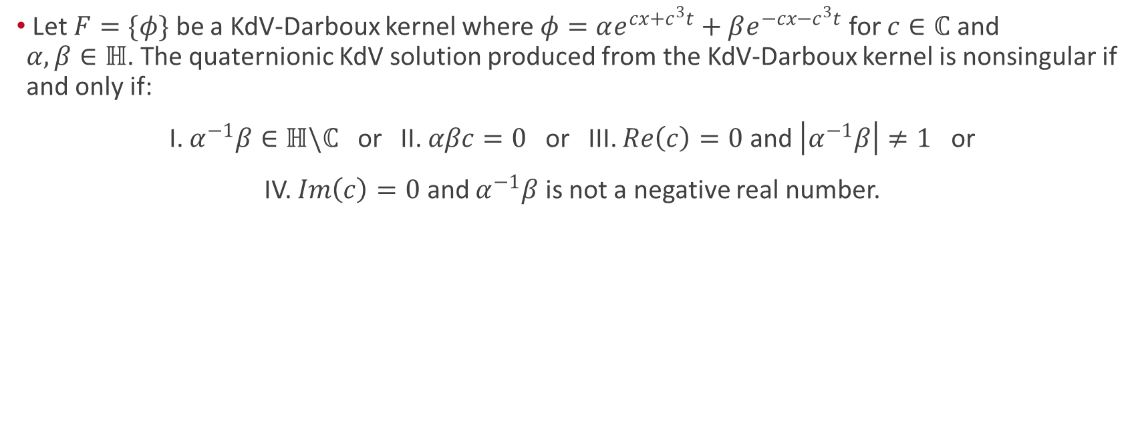
1-Soliton Singularities
Let $F=\{φ\}$ be a KdV-Darboux kernel where $φ=αe^{cx+c^{3}t}+βe^{−cx−c^{3}t}$ for $c∈ℂ$ and $α,β∈ℍ$. The quaternionic KdV solution produced from the KdV-Darboux kernel is nonsingular if and only if:
I. $α^{−1}β∈ℍ\backslash ℂ$ or II. $αβc=0$ or III. $Re\left(c\right)=0$ and $\left|α^{−1}β\right|≠1$ or
IV. $Im\left(c\right)=0$ and $α^{−1}β$ is not a negative real number.

Slide 12
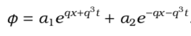
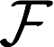
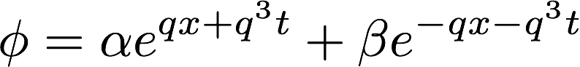
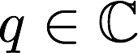
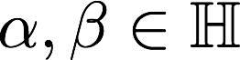
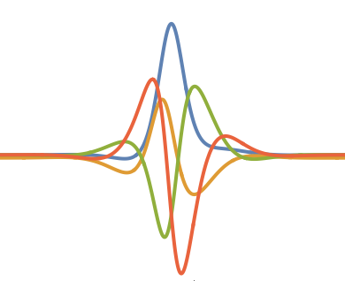
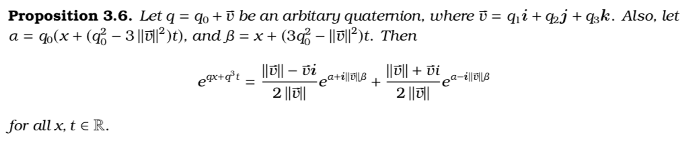
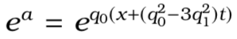
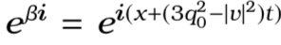
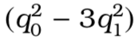
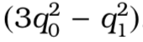




2-Soliton Interactions: Properties of 1-Soliton
It can be shown that, as in the real case, the general function in for the generation of a 1-soliton is
where and . The following results comes from Euler’s formula.
envelope
part
periodic
part
The previous decomposition shows that has both an envelope part and a periodic part
. The envelope part has a separate velocity of while the periodic part has a velocity of v .
Using that fact that we can see that the center of the soliton will occur when is minimized. By minimizing , and ignoring small trigonometric terms, we find that the center is at
.

Slide 13

2-Soliton Interactions: The Direct Scattering Problem
Real 2-Soliton Interaction
It may seem that the 2-soliton is a direct sum of two different 1-solitons, but as they pass through one another, there is a phase shift.
This phase shift is dependent only on the velocities of the constituent incoming 1-solitons before interaction, like in kinetics.

Slide 14


2-Soliton Interactions: The Direct Scattering Problem
Real 2-Soliton Interaction
It may seem that the 2-soliton is a direct sum of two different 1-solitons, but as they pass through one another, there is a phase shift.
This phase shift is dependent only on the velocities of the constituent incoming 1-solitons before interaction, like in kinetics.
The Direct Scattering Problem: Given information about the two solitons at an initial time before impact, and their respective velocities, we can solve for the two 1-solitons after.

Slide 15


2-Soliton Interactions: The Direct Scattering Problem
Real 2-Soliton Interaction
Quaternionic 2-Soliton Interaction

Slide 16



2-Soliton Interactions: The Trivial Solution Shift
Lemma. Suppose $ℱ=\left\{φ_{1},φ_{2},. . ., φ_{n}\right\}$ is a KdV Darboux kernel and that $Q$ is a constant coefficient DO. Then $Q\left(ℱ\right)=\{Q\left(φ_{1}\right),Q\left(φ_{2}\right),. . ., Q\left(φ_{n}\right)\}$ is also a KdV Darboux kernel.
Lemma. Suppose $ℱ=\left\{φ_{1},φ_{2},. . ., φ_{n}\right\}$ is a KdV Darboux kernel. Let $g_{i}=α_{i}e^{q_{ix}+q_{i}^{3}t}$ for
$0<i≤N$ index some $N$ trivial eigenfunctions and let $Q$ be the unique monic constant coefficient DO with the functions $g_{i}$ in its kernel. Then the bigger set $ℱ∪g_{i}=\{φ_{1}, . . ., φ_{n},g_{1},. . . , g_{N}\}$ is also a KdV Darboux kernel such that $Ω\left(ℱ∪g_{i}\right)=Ω\left(Q\left(ℱ\right)\right).$
Theorem. Suppose $ℱ=\left\{φ_{1},φ_{2},. . ., φ_{n}\right\}$ and $\hat{φ}∉$ Span⟨ $ℱ$⟩ where $\hat{φ}=αe^{qx+q^{3}t}+βe^{−qx−q^{3}t}$ and $q=q_{0}+q_{1}i$ with $q_{0}>0$. If $u=Ω(\hat{ℱ})$ where $\hat{ℱ}=ℱ∪\hat{φ},$ then
$u→Ω(ℱ_{+})$ on the right
$u→Ω(ℱ_{−})$ on the left
Where
$ℱ_{−}=\{Q_{−}\left(φ_{1}\right), . . ., Q_{−}\left\{φ_{n}\right\}\}$ $Q_{−}=∂+βqβ^{−1}$
$ℱ_{+}=\{Q_{+}\left(φ_{1}\right), . . ., Q_{+}\left\{φ_{n}\right\}\}$ $Q_{−}=∂+αqα^{−1}$
Notes:
Stick to the 2 soliton case.

Slide 17








2-Soliton Interactions: The Trivial Solution Shift
Theorem. Suppose $ℱ=\left\{φ_{1},φ_{2},. . ., φ_{n}\right\}$ and $\hat{φ}∉$ Span⟨ $ℱ$⟩ where $\hat{φ}=αe^{qx+q^{3}t}+βe^{−qx−q^{3}t}$ and $q=q_{0}+q_{1}i$ with $q_{0}>0$. If $u=Ω(\hat{ℱ})$ where $\hat{ℱ}=ℱ∪\hat{φ},$ then
$u→Ω(ℱ_{+})$ on the right
$u→Ω(ℱ_{−})$ on the left
Where
$ℱ_{−}=\{Q_{−}\left(φ_{1}\right), . . ., Q_{−}\left\{φ_{n}\right\}\}$ $Q_{−}=∂+βqβ^{−1}$
$ℱ_{+}=\{Q_{+}\left(φ_{1}\right), . . ., Q_{+}\left\{φ_{n}\right\}\}$ $Q_{−}=∂+αqα^{−1}$
Consider $Ω\left(\left\{φ_{1},φ_{2}\right\}\right)$.
($Ω(\left\{φ_{1}\right\})$ is a soliton, $Ω(\left\{φ_{2}\right\})$ is a periodic solution)
The theorem above states that the periodic solution on the left is
$$Ω\left({\left\{φ_{1}\right\}}_{−}\right)=Ω(\left\{Q_{−}\left(φ_{2}\right)\right\})$$
Similarly, the portion on the right is
$$Ω\left({\left\{φ_{1}\right\}}_{+}\right)=Ω(\left\{Q_{+}\left(φ_{2}\right)\right\})$$
Notes:
It looks like it, not the same. Its the limit.

Slide 18











2-Soliton Interactions: Phase Shifts
Before collision
After collision
Using the theorem from the previous section, we can completely describe each 1-soliton before and after collision.
Then, we can find the difference between the soliton centers before and after the collision.
So, unlike the real case, the quaternionic phase shift depends on the coefficients of $φ_{i}$. Note that this form collapses to the known real phase shift when all the variables involved are real.

Slide 19







2-Soliton Interactions: Phase Shifts
Before collision
After collision
This shift can be seen most clearly by plotting the lines corresponding to the center of each 1-soliton.
Theorem. Let $u_{2}\left(x,t\right)$ be a 2-soliton solution to the QKdV equation. Let
$ξ_{1}=\ln{\frac{|β_{1}q_{1}β_{1}^{−1}α_{2}+α_{2}q_{2}|}{|β_{1}q_{1}β_{1}^{−1}β_{2}−β_{2}q_{2}|}}$ and $ξ_{2}=\ln{\frac{|α_{1}q_{1}α_{1}^{−1}β_{1}+β_{1}q_{1}|}{|α_{2}q_{2}α_{2}^{−1}α_{1}−α_{1}q_{1}|}}$
We define the following lines:
$$l_{1}^{−}:x=v_{2}t+\frac{ξ_{2}+\ln{ε}}{2a_{2}} l_{2}^{−}:x=v_{1}t+\frac{ξ_{1}}{2a_{1}}$$
$$l_{1}^{+}:x=v_{2}t+\frac{ξ_{2}}{2a_{2}} { l}_{2}^{+}:x=v_{1}t+\frac{ξ_{1}−\ln{ε}}{2a_{1}}$$
Lemma. As $t→±∞,$ $u_{2}\left(x,t;q_{1},q_{2},α_{1},α_{2},β_{1},β_{2}\right)→s_{2}^{±}+s_{1}^{∓},$ which have linear trajectories given by the lines $l_{2}^{±}$ and $l_{2}^{∓}$ respectively.
Additionally, the coefficients can be chosen to control the resulting phase shift, including solutions with no phase shift whatsoever!

Slide 20

Rational Solutions
· Constructed using $∆_{m}=\frac{∂^{m}}{∂k^{m}}e^{kx+k^{3}t}{\left.​\right|}_{k=0}$
· V
· KdV-Darboux Kernel is $F=\left\{ϕ,ϕ_{xx},…ϕ_{M}\right\} where M=m−1 when m is odd and M=m when m is even.$
· Ω(F)=u(x,t) where u(x,t) is a rational solution to the KdV equation.
· Is sufficient to consider ${ф=∆}_{2m+1}+\sum_{i=0}^{m}{∆_{2i}α_{i}}$.

Slide 21


Short animation
$$Ф= ∆_{5}\left\{1,0,0,0\right\}+∆_{4}\{0,1,0,1\text{+}∆_{2}\{0,0,1,1\}\text{+}∆_{0}\{0,1,1,1\}$$
Notes:
Anyone have an idea on how to fix the spacing on this slide? It’s being really finnicky.

